Slide 1
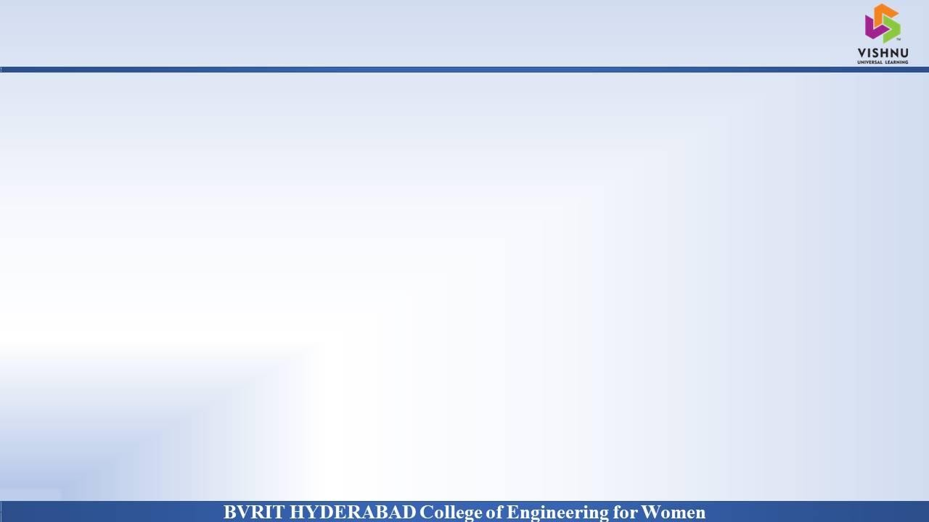
Department of Computer Science and Engineering
Detection and Classification of Fruit Diseases
Date: 23 April 2021
Medaramatla Gayatri - 17WH1A0540
Uskoila Mounika - 17WH1A0550
Sama Nischala - 18WH5A0506
Internal Guide : Ms. A Kranthi Designation : Assistant Professor

Slide 2


Abstract
Why Should I Study this course?
Examples
BVRIT HYDERABAD College of Engineering for Women
Problem Statement:
This project aims at detection of fruit diseases at early stage since it will affect the agriculture field. The Disease is a major problem arising in an agriculture field. In plants most of the leaves and fruits are affected by diseases due to bacteria and virus.
Project Objective:
To build an algorithm to automatically detect and segment diseases in fruits images. Some of the challenging factors include flaws in image quality like uneven brightness, obstruction, many images which have similar shape, color and texture.

Slide 3
Dataset
Why Should I Study this course?
Examples
BVRIT HYDERABAD College of Engineering for Women
Dataset Description:
A public dataset from Kaggle and Mendeley on the Fruit Disease Detection Challenge is taken. The total size of the dataset is 150Mb.
The dataset has the images of fruits and the leaves with the features of
blackspot.
Canker
Greening
Healthy
Scab
The dataset contains more than 1300 images
For prediction apply the K-Means Algorithm and SVM models on the dataset by splitting the datasets in to 70 to 80% of training with these models and 30 to 20% of testing for predicting

Slide 4
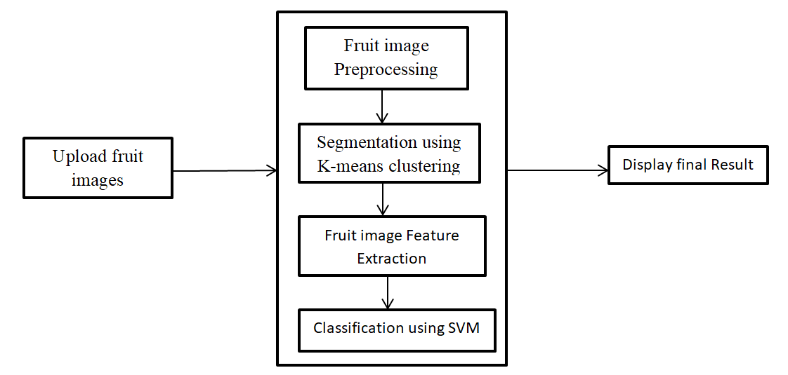
Architecture
Why Should I Study this course?
Examples
BVRIT HYDERABAD College of Engineering for Women

Slide 5
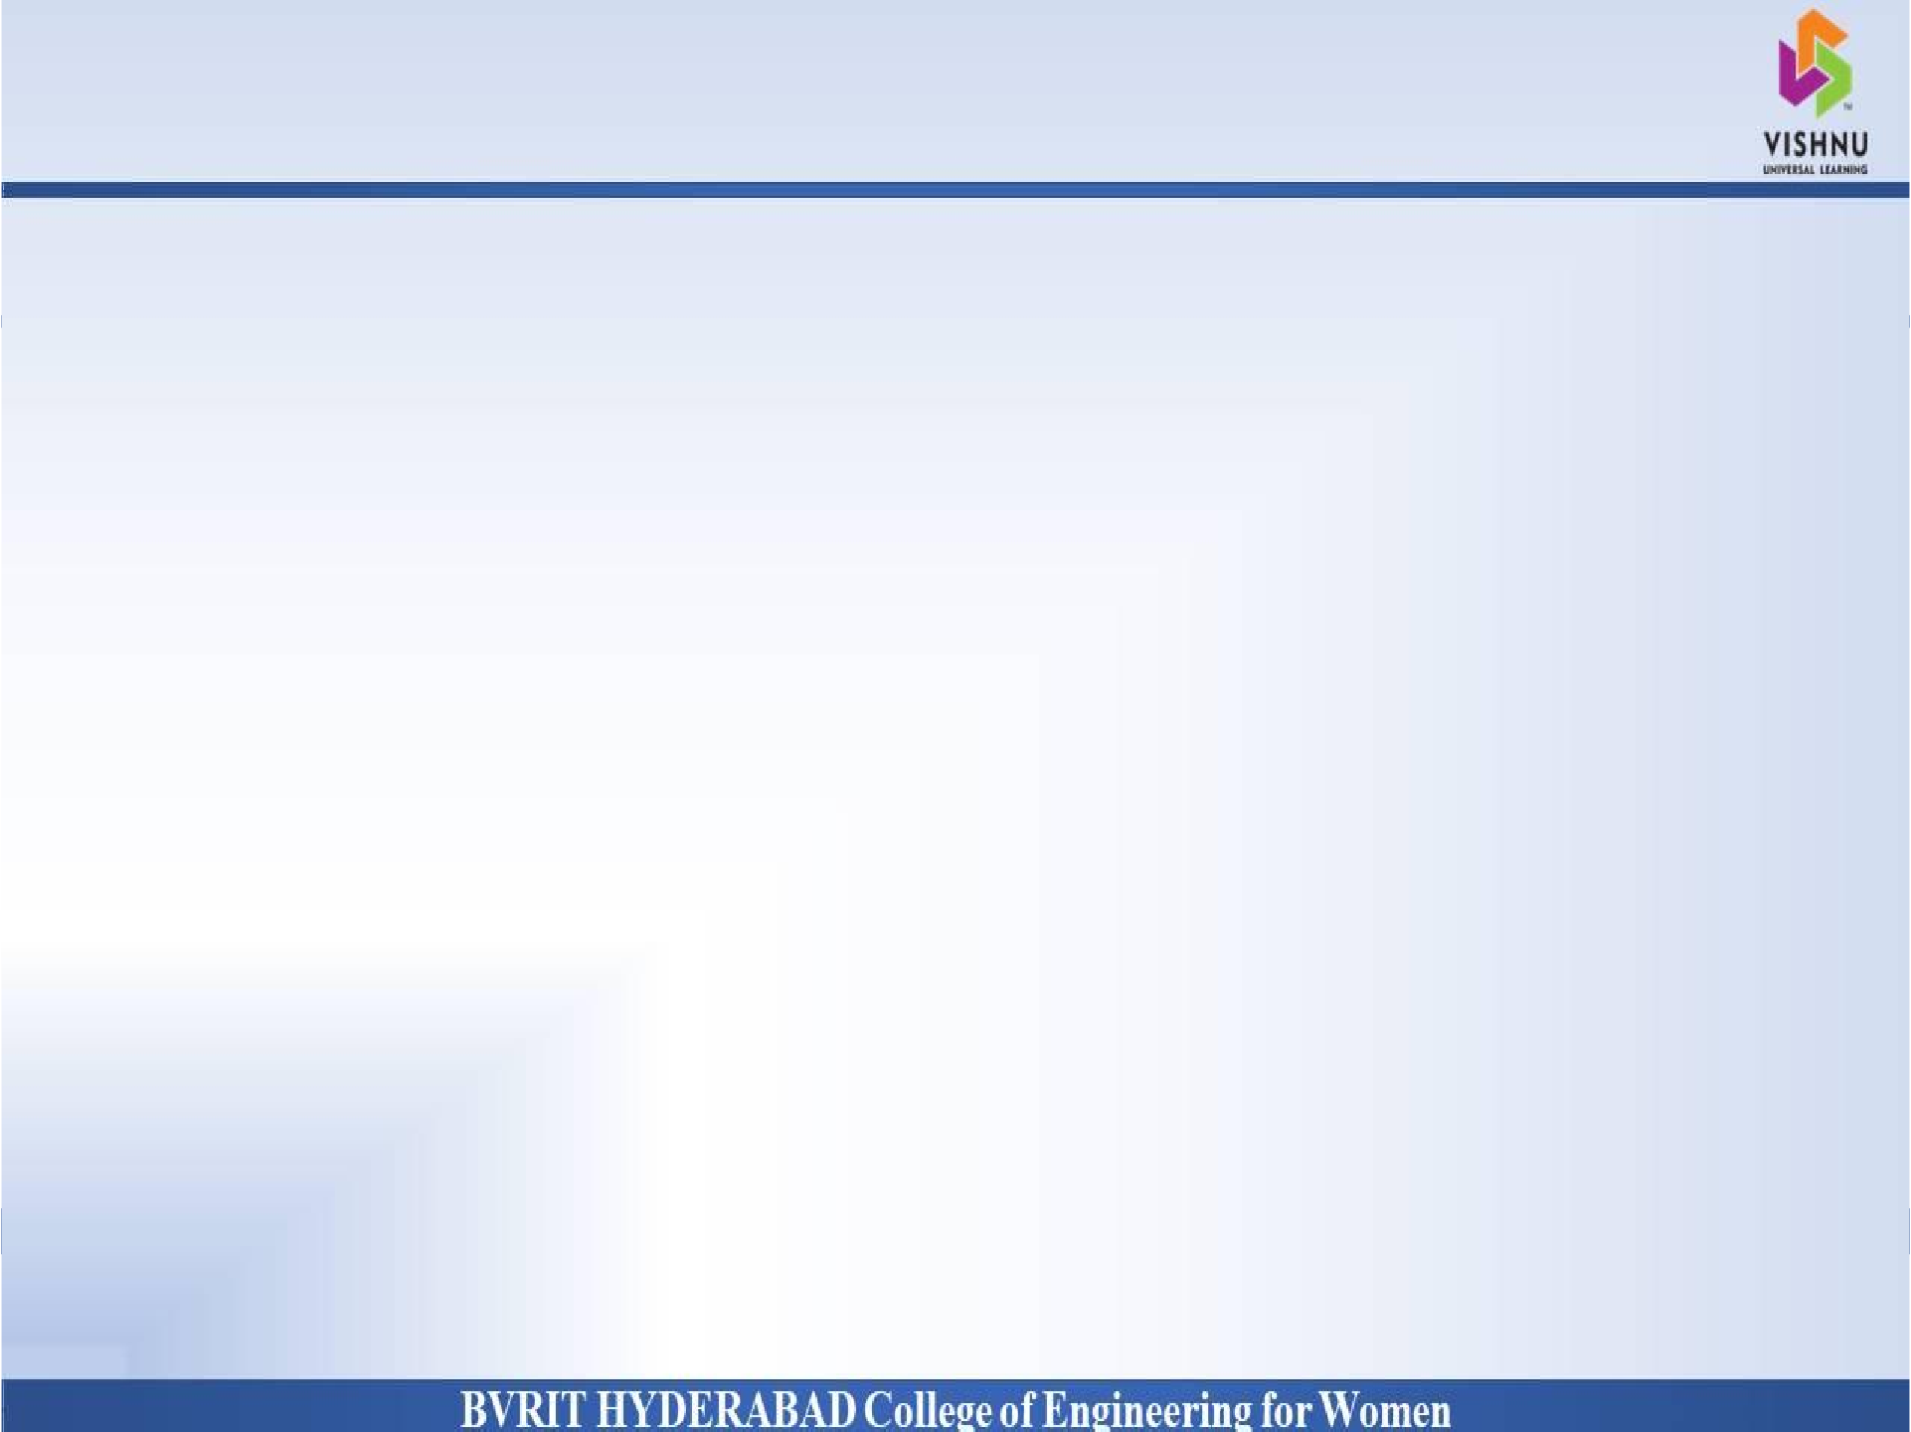
Technology Stack
Why Should I Study this course?
Examples
BVRIT HYDERABAD College of Engineering for Women
Classification & segementation – K-Means Algorithm and SVM technique
Python
Machine Learning
Tkinter
Packages & Libraries :
N
NumPy , Pandas , Keras, sklearn, tkinterable
Matplotlib
TensorFlow , opencv

Slide 6
System Requirements
Why Should I Study this course?
Examples
BVRIT HYDERABAD College of Engineering for Women
Environment | Speciﬁcations
Hardware | Memory - 8GB RAM Intel I5 Core Processor Hard Disk : 250 Gb
Software | Operating System: windows, linux Python idel 3.7 version or Anaconda 3.7 or Google colab

Slide 7
Timeline
Why Should I Study this course?
Examples
BVRIT HYDERABAD College of Engineering for Women
Review 0 | Abstract Base paper and References
Review 1 | Software Requirements Gathering of Data Architecture Base paper and References
Review 2 | Review-i slides Partial implementation of features
Review 3 | Complete implementation Results & Discussions
 | Report of the Project

Slide 8
References
Why Should I Study this course?
Examples
BVRIT HYDERABAD College of Engineering for Women
Base paper:
https://ieeexplore.ieee.org/document/9104139
References:
https://www.irjet.net/archives/V4/i12/IRJET-V4I12213.pdf
https://www.kaggle.com/mcbean/fruit-classification-w-nn
https://data.mendeley.com/datasets/3f83gxmv57/2

Slide 9
Thank you

